Slide 1



Sixth/Seventh Semester
Essentials of Management
HUM-4001
Strategic Planning Tools
Faculty, Dept. of Humanities and Management,
Manipal Institute of Technology - Manipal

Slide 2
3 levels of Strategy
Corporate level strategy: What business we are in?
Business level strategy or competitive strategy: How do we compete?
Functional-level strategy: How do we support business level strategy?

Slide 3
Learning Objectives
Strategic Planning Tools
Critical question analysis
SWOT analysis
Business portfolio analysis
Porter’s Model for Industry Analysis

Slide 4
Tools to develop Strategy
Critical question analysis.
SWOT analysis.
Business portfolio analysis.
Porter’s model for Industry analysis.
These 4 strategy development tools are related but distinct. Managers should use the tool or combination of tools that seem most appropriate for them and their organizations.

Slide 5
Critical Question Analysis
What is our business?
Glass bottle manufacturers missed their opportunities by seeing themselves for too long as glass bottle makers rather than as liquid container manufacturers while plastic and metal containers come to replace glass in many cases.
Who are our customers?
What do our customers want?
How much will our customers buy and at what price?
Do we wish to be a product leader?
Do we wish to develop our own new products?

Slide 6
Critical Question Analysis….
An example of critical question analysis:
The key questions that serve as guides for establishing a marketing strategy are:
Where are our customers and why do they buy?
How do our customers buy?
How is it best for us to sell?
Do we have something to offer that competitors do not?

Slide 7

SWOT Analysis
Strengths
Acronym for Strengths, Weaknesses, Opportunities, and Threats.
Technique is credited to Albert Humphrey who led a research project at Stanford University in the 1960s and 1970s.
SWOT
Analysis
Oppurtunity
Weakness
Planning tool used to understand Strengths, Weaknesses, Opportunities, & Threats involved in a project / business.
Used as framework for organizing and using data and information gained from situation analysis of internal and external environment.
Threats
Technique that enables a group / individual to move from everyday problems / traditional strategies to a fresh perspective.

Slide 8
What is SWOT Analysis?
STRENGTHS
Characteristics of the business or a team that give it an advantage over others in the industry.
Positive tangible and intangible attributes, internal to an organization.
Beneficial aspects of the organization or the capabilities of an organization, which includes human competencies, process capabilities, financial resources, products and services, customer goodwill and brand loyalty.
Examples - Abundant financial resources, Well-known brand name, Economies of scale, Lower costs [raw materials or processes], Superior management talent, Better marketing skills, Good distribution skills, Committed employees.

Slide 9
What is SWOT Analysis?
WEAKNESSES
Characteristics that place the firm at a disadvantage relative to others.
Detract the organization from its ability to attain the core goal and influence its growth.
Weaknesses are the factors which do not meet the standards we feel they should meet. However, weaknesses are controllable. They must be minimized and eliminated.
Examples - Limited financial resources, Weak spending on R & D, Very narrow product line, Limited distribution, Higher costs, Out-of-date products / technology, Weak market image, Poor marketing skills, Limited management skills, Under-trained employees.

Slide 10
What is SWOT Analysis?
OPPORTUNITIES
Chances to make greater profits in the environment - External attractive factors that represent the reason for an organization to exist & develop.
Arise when an organization can take benefit of conditions in its environment to plan and execute strategies that enable it to become more profitable.
Organization should be careful and recognize the opportunities and grasp them whenever they arise. Opportunities may arise from market, competition, industry/government and technology.
Examples - Rapid market growth, Rival firms are complacent, Changing customer needs/tastes, New uses for product discovered, Economic boom, Government deregulation, Sales decline for a substitute product .

Slide 11
What is SWOT Analysis?
SWOT ANALYSIS - THREAT
THREATS
External elements in the environment that could cause trouble for the business - External factors, beyond an organization’s control, which could place the organization’s mission or operation at risk.
!
Arise when conditions in external environment jeopardize the reliability and profitability of the organization’s business.
Compound the vulnerability when they relate to the weaknesses. Threats are uncontrollable. When a threat comes, the stability and survival can be at stake.
!
Examples - Entry of foreign competitors, Introduction of new substitute products, Product life cycle in decline, Changing customer needs/tastes, Rival firms adopt new strategies, Increased government regulation, Economic downturn.

Slide 12
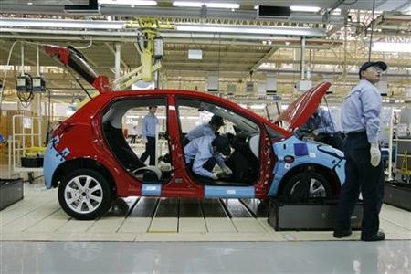
Exercise
Assume that a car manufacturing company has recently launched its electrical vehicle (EV) products. Perform a SWOT analysis for the same.

Slide 13
Exercise
STRENGTHS
WEAKNESSES
No Competition in the EV Segment.
Environment friendly
Economic to Drive [Rs. 0.4 per km] *
Government subsidies [8% excise duty] *
High Price
Low aesthetic appeal
Small driving range [up to 80 KM]
Competition from gasoline vehicles
Helpful
Internal
OPPORTUNITIES
THREATS
Huge untapped EV market
Growing demand of green technologies
Rising fuel costs
Growing road congestion in urban cities
Government incentives to gasoline vehicles
Entry of competitors
Stringent safety requirements anticipated
Availability of hybrid vehicles
External
* Hypothetical figures
Harmful

Slide 14
TOWS Matrix
It has four alternative strategies
The WT Strategy
The WO Strategy
The ST Strategy
The SO Strategy

Slide 15
TOWS Matrix for Strategy Formulation
Internal strengths (S)
e.g., strengths in management operations, finance, marketing, R&D, engineering
Internal weaknesses(W)
e.g., weaknesses in areas shown in the box of “strengths”
Internal factors
External factors
External Opportunities (O)
(Consider risks also)
e.g., current and future economic condition, political and social changes, new products, services and technology
SO strategy: Maxi- Maxi
Potentially the most successful strategy, utilizing the organization’s strengths to take advantage of opportunities
WO strategy: Mini-Maxi
e.g., Developmental strategy to overcome weaknesses in order to take advantage of opportunities
External threats (T)
e.g., lack of energy, competition, and areas similar to those shown in the “opportunities” box above
ST strategy: Maxi-Mini
e.g., use of strengths to cope with threats or to avoid threats
WT strategy: Mini- Mini
e.g., retrenchment, liquidation, or joint venture to minimize both weaknesses and threats

Slide 16
Retrenchment strategy
A strategy used by corporations to reduce the diversity or the overall size of the operations of the company.
This strategy is often used in order to cut expenses with the goal of becoming a more financial stable business.
Typically the strategy involves withdrawing from certain markets or the discontinuation of selling certain products or service in order to make a beneficial turnaround.

Slide 17
Dynamics of the TOWS Matrix
S
W
O
SO
WO
Internal factors
T
ST
WT
S
W
O
SO
WO
External factors
T
ST
WT
S
W
O
SO
WO
T
ST
WT
S
W
Time
O
SO
WO
T
ST
WT

Slide 18
Strategic Business Units (SBU)
Large companies normally manage quite different businesses, each requiring its own strategy.
At one time General Electric classified its businesses into 49 Strategic Business Units (SBUs).
The best example of SBU are companies like Proctor and Gamble, LG etc. These companies have different product categories under one roof. For example, LG as a company makes consumer durables. It makes refrigerators, washing machines, air-conditioners as well as televisions.
Notes:
A strategic business unit has three characteristics: 1) It is a single business, or a collection of related businesses, that plan separately from the rest of the company; 2) It has its own set of competitors; and 3) It has a manager responsible for strategic planning and profit performance.

Slide 19
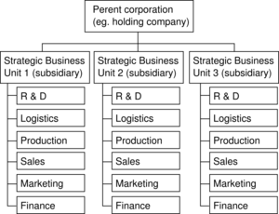
Strategic Business Units (SBU)
Apple's business strategy cuts across all the three Strategic Business Units i.e. Computer unit, Telecommunications unit and Music & Video unit.
Notes:
A strategic business unit has three characteristics: 1) It is a single business, or a collection of related businesses, that plan separately from the rest of the company; 2) It has its own set of competitors; and 3) It has a manager responsible for strategic planning and profit performance.

Slide 20
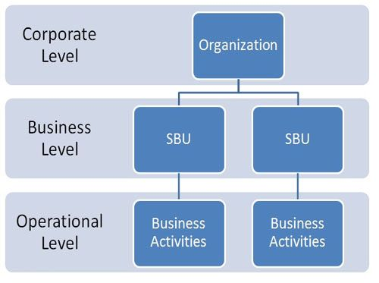
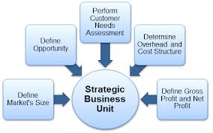
Strategic Business Units (SBU)
Notes:
A strategic business unit has three characteristics: 1) It is a single business, or a collection of related businesses, that plan separately from the rest of the company; 2) It has its own set of competitors; and 3) It has a manager responsible for strategic planning and profit performance.

Slide 21


Strategic Business Units (SBU)
Three Characteristics of an SBU:
Unique competitors
A single business or collection of related businesses
Leader responsible for planning and profitability
Notes:
A strategic business unit has three characteristics: 1) It is a single business, or a collection of related businesses, that plan separately from the rest of the company; 2) It has its own set of competitors; and 3) It has a manager responsible for strategic planning and profit performance.

Slide 22



Defining Strategic Business Units
Customer groups
Customer needs
Technology
Notes:
Companies often define themselves in terms of the products it produces. This view often limits a company. A market definition on the other hand describe the business as a customer-satisfying process. For example, if Xerox defined itself from only a product perspective (We make copying equipment) it would limit its ability to market products and services other than copiers.
SBUs can be defined by: 1) Customer needs; Customer groups; and 3) Technology

Slide 23
Business Portfolio Analysis
The Business Porfolio Matrix or the Growth-Share Matix was developed by Boston Consulting Group (BCG) in 1970s.
According to this technique, businesses or products are classified as low or high performers depending upon their market growth rate and relative market share.

Slide 24
Business Portfolio Analysis…
It is a portfolio planning model which is based on the observation that a company’s business units can be classified in to four categories:
Stars
Question marks
Cash cows
Dogs
It is based on the combination of market growth and market share relative to the next best competitor.

Slide 25
Business Portfolio Analysis
Boston Consulting Group (BCG) Matrix is a four celled matrix developed by BCG, USA.
The Boston Consulting Group (BCG) growth/share matrix in among the best known of these approaches.
In the BCG approach, each of the firm’s Strategic Business Units (SBUs) is plotted on a two-dimensional grid in which the axes are relative market share and industry growth rate.
The grid is broken into two quadrants. It is a most renowned corporate portfolio analysis tool.
High
Business growth rate
Low
High
Low
Relative position (Market Share)

Slide 26
Business Portfolio Analysis
According to the BCG Matrix, business could be divided into high or low depending upon their industry growth and relative market share.
Relative Market Share = SBU Sales this year / leading competitors sales this year.
Market Growth Rate = Industry sales this year - Industry Sales last year.
The analysis requires that both measures be calculated for each SBU. The dimension of business strength, relative market share, will measure comparative advantage indicated by market dominance. The key theory underlying this is existence of an experience curve and that market share is achieved due to overall cost leadership.

Slide 27
Business Portfolio Analysis…
STARS – High Growth, High Market Share
Stars are leaders in business.
They also require heavy investment, to maintain its large market share.
It leads to large amount of cash consumption and cash generation.
Attempts should be made to hold the market share otherwise the star will become a CASH COW.

Slide 28
Business Portfolio Analysis…
CASH COWS - Low growth , High market share
They are foundation of the company and often the stars of yesterday.
They generate more cash than required.
They extract the profits by investing as little cash as possible
They are located in an industry that is mature, not growing or declining.

Slide 29
Business Portfolio Analysis…
DOGS - Low growth, Low market share
Dogs are the cash traps.
Dogs do not have potential to bring in much cash.
Number of dogs in the company should be minimized.
Business is situated at a declining stage.

Slide 30
Business Portfolio Analysis…
QUESTION MARKS - High growth, Low market share
Most businesses start of as question marks.
They will absorb great amounts of cash if the market share remains unchanged, (low).
Why question marks?
Question marks have potential to become star and eventually cash cow but can also become a dog.
Investments should be high for question marks.

Slide 31
Business Portfolio Analysis
Stars are SBUs competing in the high-growth industries with relatively high market shares. These firms have long-term growth potential and should continue to receive substantial investment funding
Stars
Question marks
Question marks are SBUs competing in high-growth industries but having relatively weak market shares. Resources should be invested in them to enhance their competitive positions
?
These are SBUs with high market shares in low-growth industries. These units have limited long-run potential but represent a source of current cash flows to fund investments in “stars” and “question marks”
Cash cows
Dogs
Dogs are SBUs with weak market shares in low-growth industries. Because they have weak position and limited potential, most analysts recommend that they be divested
Each of the four quadrants of the grid has different implication for the SBUs that fall into the category

Slide 32
Business Portfolio Analysis
BCG Matrix application
The BCG Matrix method can help to understand a frequently made strategy mistake: having a one size fits all strategy approach, such as a generic growth target or a generic return on capital for an entire corporation.
Cash Cows Business Units will reach their profit target easily. Their management have an easy job. Even worse, they are often allowed to reinvest substantial cash amounts in their mature businesses
High
Dogs Business Units are fighting an impossible battle and, even worse, now and then investments are made. These are hopeless attempts to "turn the business around"
Business growth rate
As a result all Question Marks and Stars receive only mediocre investment funds. In this way they can never become Cash Cows. Inadequate invested sums of money are a waste of money
Low
Either these SBUs should receive enough investment funds to enable them to achieve a real market dominance and become Cash Cows (or Stars), or otherwise companies are advised to disinvest. They can then try to get any possible cash from the Question Marks that were not selected
High
Low
Relative position (Market Share)

Slide 33
Business Portfolio Analysis…
Benefits
BCG MATRIX is simple and easy to understand.
It helps you to quickly and simply screen the opportunities open to you, and helps you think about how you can make the most of them.
It is used to identify how corporate cash resources can best be used to maximize a company’s future growth and profitability.

Slide 34
Limitations of BCG Matrix
Limitations
Limitations
BCG matrix uses only two dimensions: Relative Market Share and Market Growth Rate
Problems arise while getting data for market share and market growth
High market share does not mean profits all the time
Business with low market share can be profitable too
It neglects the effects of synergy between business units
Market growth is not the only indicator for attractiveness of a market
There is no clear definition of what constitutes a “market”
The model neglects small competitors that have fast growing market shares

Slide 35
Business Portfolio Analysis…
Why BCG Matrix?
To assess :
Profiles of products/businesses
The cash demands of products
The development cycles of products
Resource allocation and divestment decisions

Slide 36
Business Portfolio Analysis…
Main Steps in BCG
Identifying and dividing a company into SBU.
Assessing and comparing the prospects of each SBU according to two criteria :
1. SBU’S relative market share.
2. Growth rate OF SBU’S industry.
Classifying the SBU’S on the basis of BCG matrix.
Developing strategic objectives for each SBU.

Slide 37
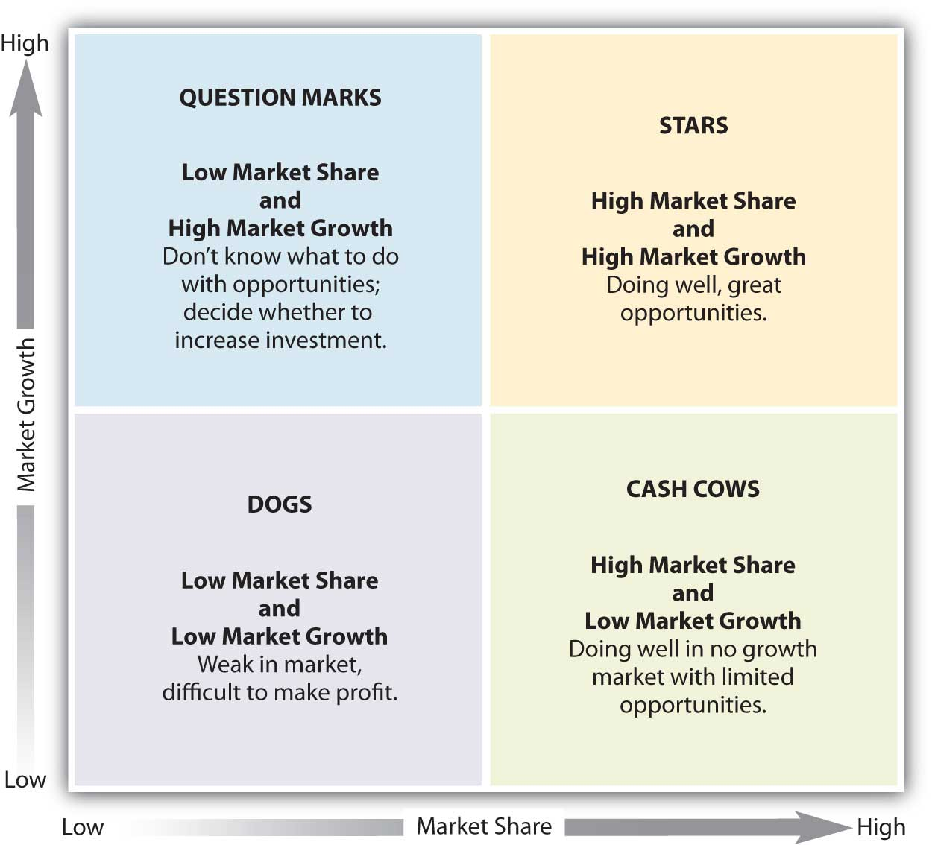

Slide 38
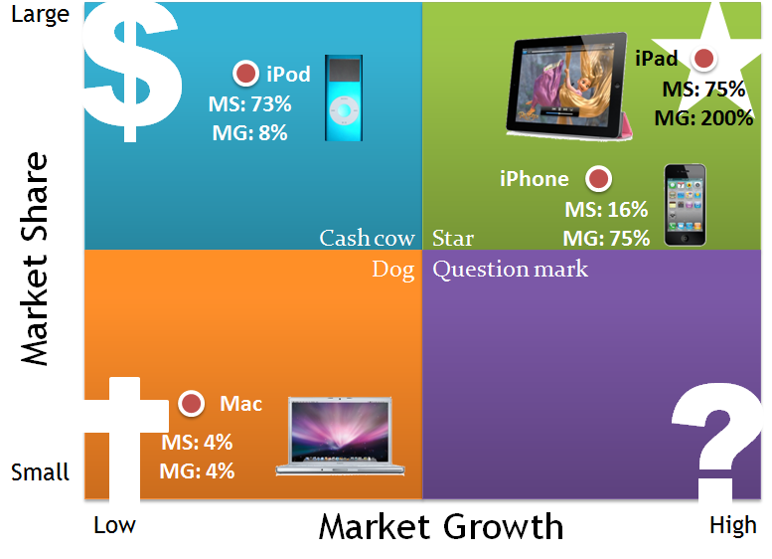
BCG for Apple

Slide 39
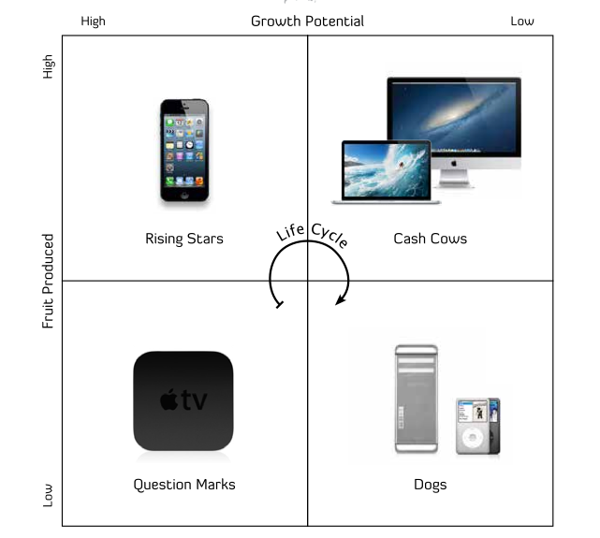

Slide 40
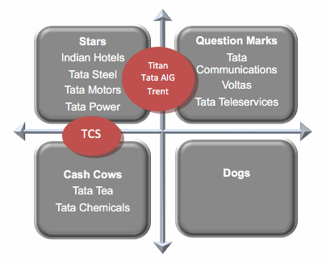
BCG for Tata Group

Slide 41
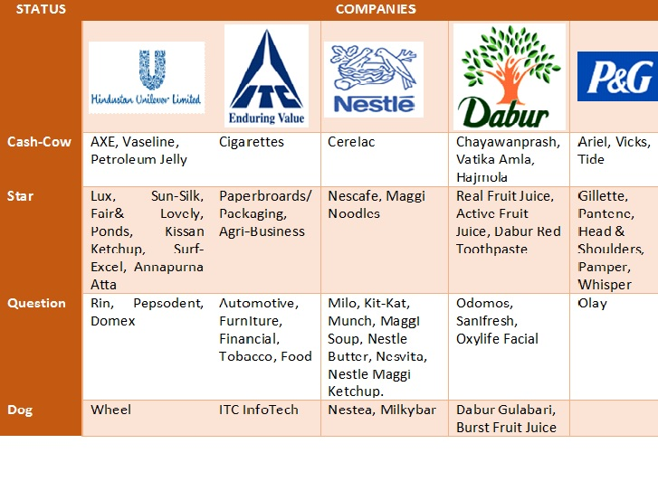

Slide 42
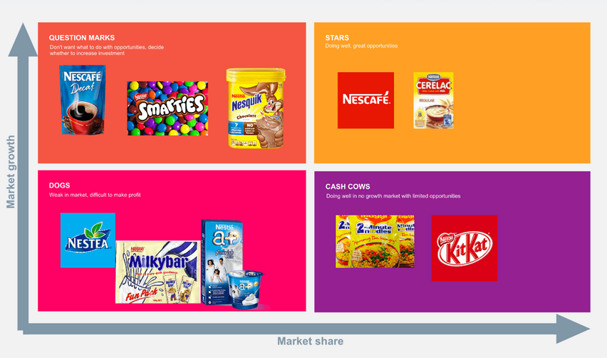

Slide 43
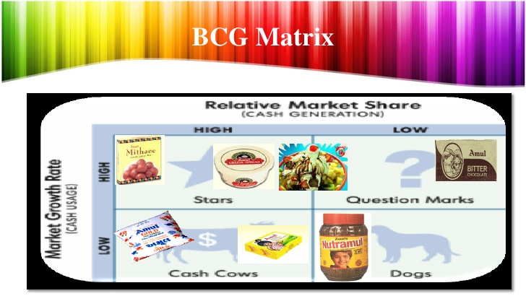

Slide 44
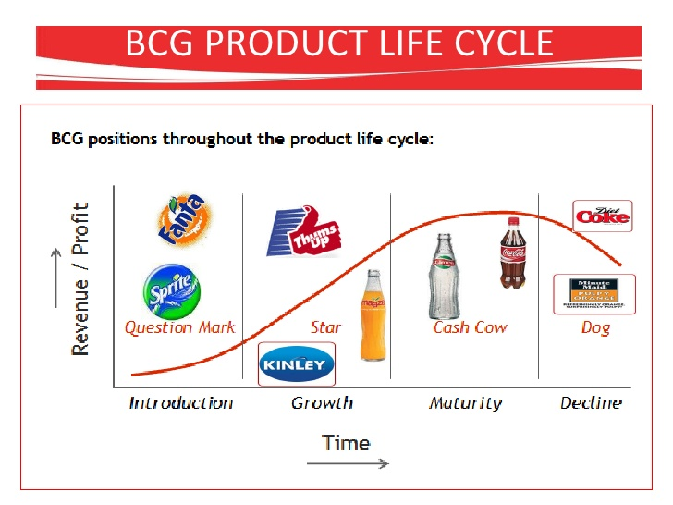

Slide 45
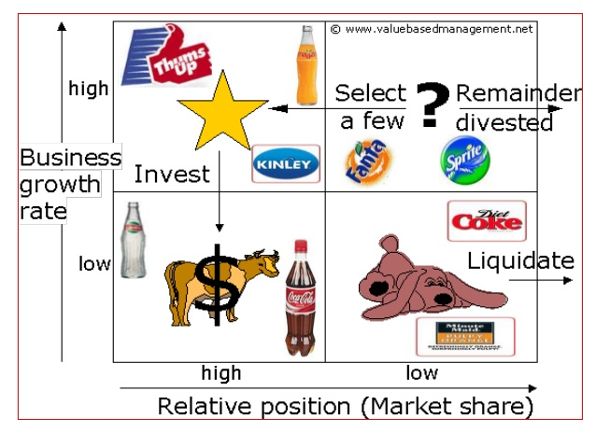

Slide 46
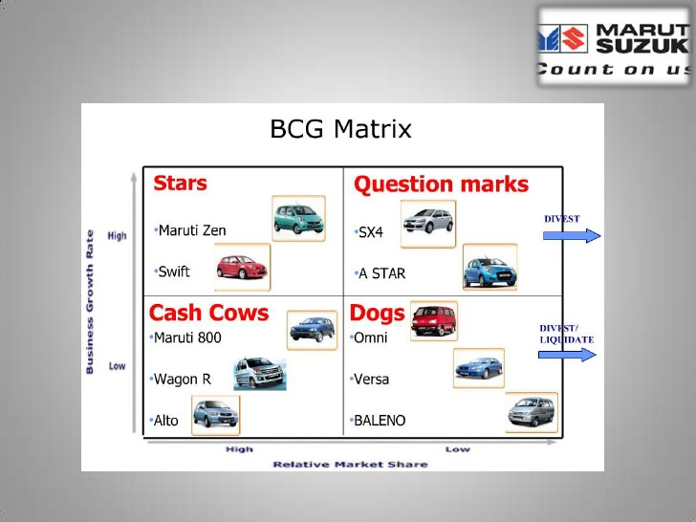

Slide 47
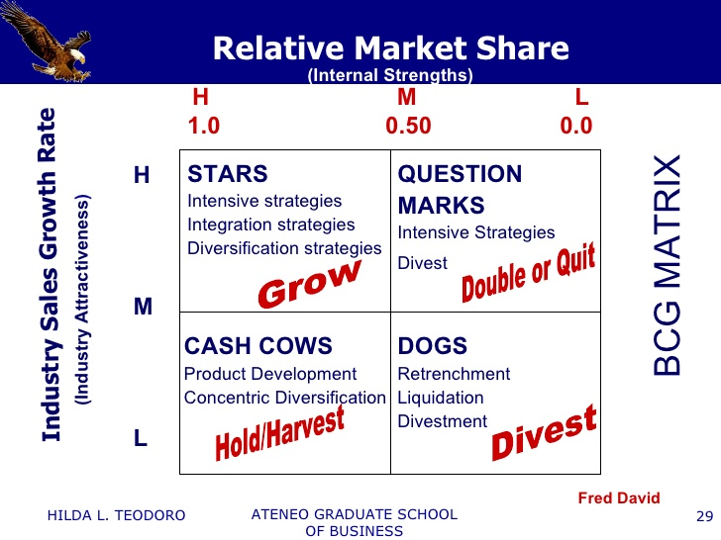

Slide 48
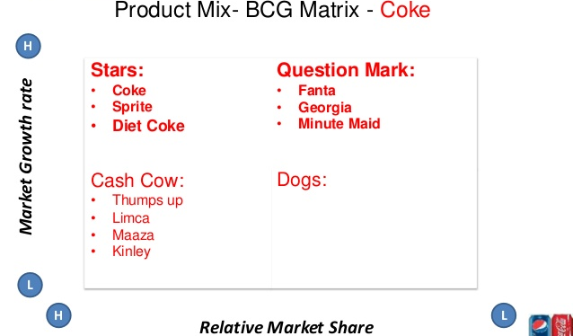

Slide 49
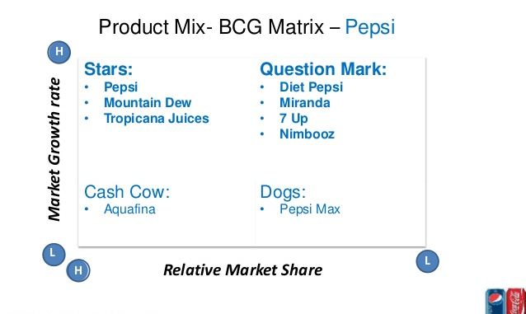

Slide 50
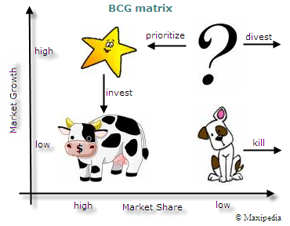

Slide 51
Business Portfolio Analysis…
Four strategies emerged from BCG Matrix:
Build
Hold/Maintain
Harvest
Divest

Slide 52
Growth Strategies…
Direct Expansion
Involves increasing a company’s size, revenues, operation, or workforce.
Merger
Occurs when two companies, usually of similar size, combine their resources to form a new company.
Acquisition
Occurs when a larger company buys a smaller one and incorporates the acquired company’s operations into its own.

Slide 53
3 Generic Competitive Strategies/Porters Generic Model

Slide 54
Overall Cost leadership strategy
An organization implementing an overall cost leadership strategy attempts to gain a competitive advantage by reducing its cost below the costs of competing firms.
Such organizations keep a close watch on costs in areas such as research and development, sales and services.
By keeping costs low, the organization is able to sell its products at low prices and still make a profit.
Eg: Timex. For decades, this firm has specialized in manufacturing relatively simple, low cost watches for the mass market.

Slide 55
Differentiation strategy
An organization that pursues a differentiation strategy seeks to distinguish from competitors by offering something unique through the quality of products or services.
Porsche sports car are indeed special; so is the Caterpillar company, which is known for its prompt service and availability of spare parts. Firms that are successfully able to implement a differentiation strategy are able to charge more than competitors because customers are willing to pay more to obtain the extra value they perceive.
EG: Rolex watches are handmade of gold and stainless steel and are subjected to strenuous tests of quality and reliability. The firms reputation enables it to charge thousands of dollars for its watches.

Slide 56
Focused strategy
A company adopting a focused strategy concentrates on a specific regional market, product line, or group of buyers. This strategy may have either a differentiation focus, whereby the firm differentiates its products in the focus market, or on overall leadership focus, whereby the firm manufactures and sells its products at low cost in the focus market.
In the watch industry, Longines follows a focus differentiation strategy by selling highly jeweled watches to wealthy female customers.
Fisher-Price uses focus differentiation strategy to sell electronic calculators with large, bright colored buttons to the parents of preschoolers.

Slide 57
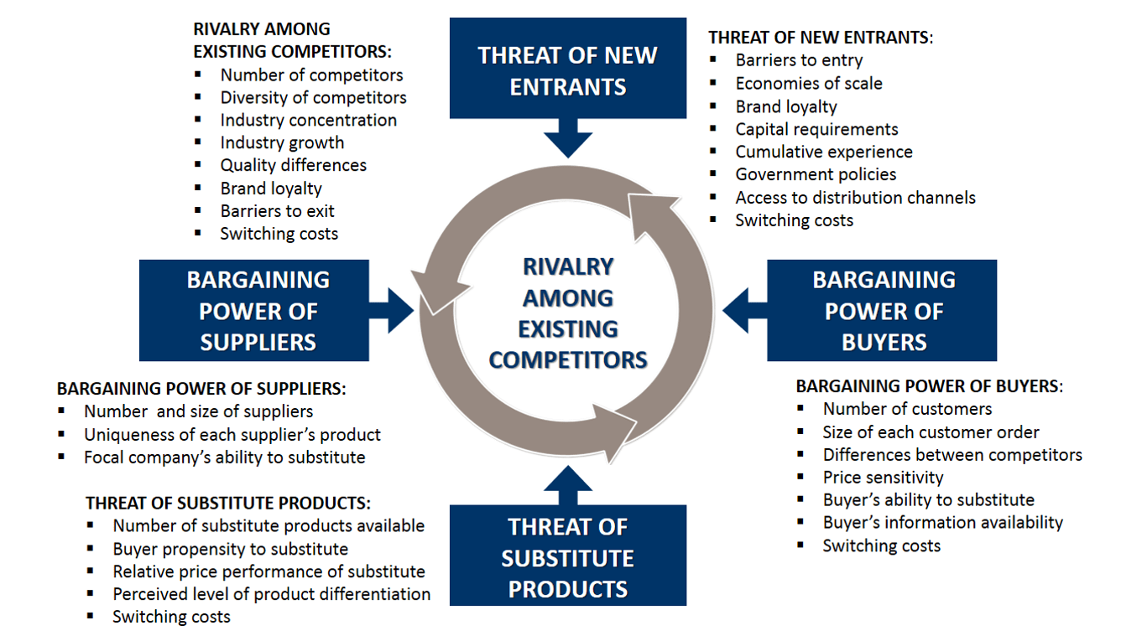
Porter’s 5 forces to analyze Competitive environment

Slide 58
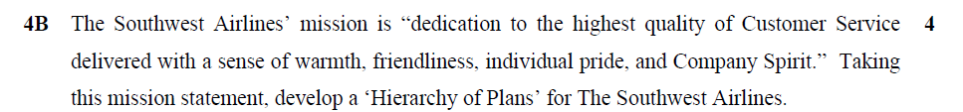
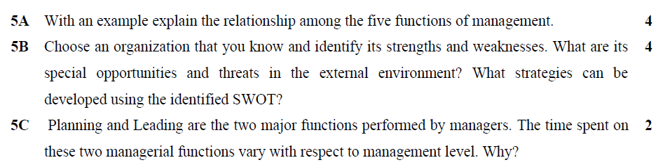
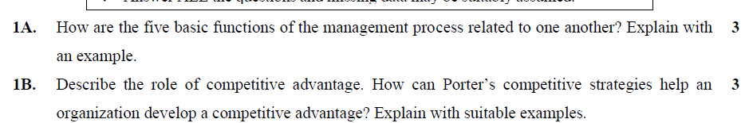

Slide 59
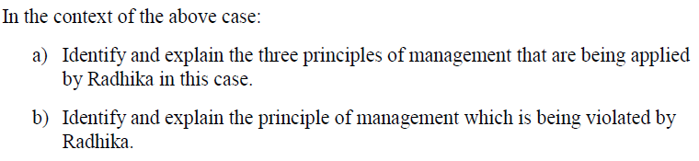
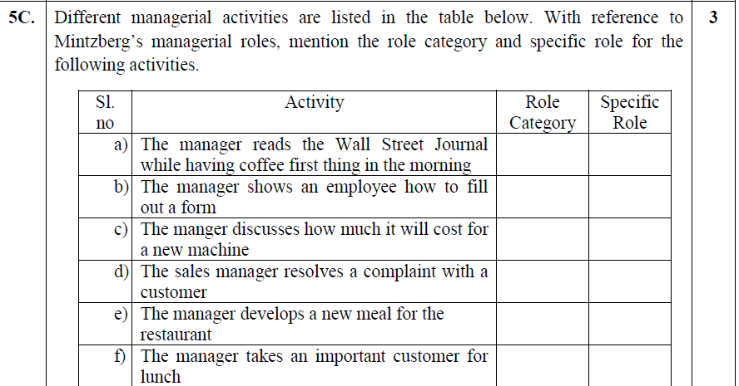

Slide 60
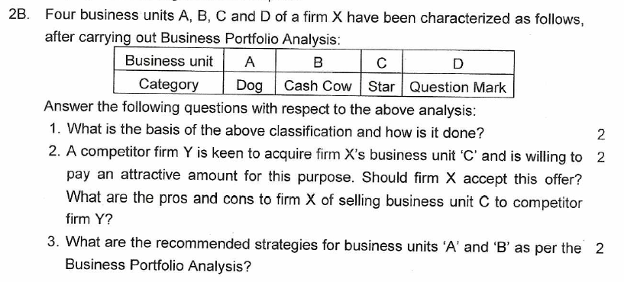

Slide 61
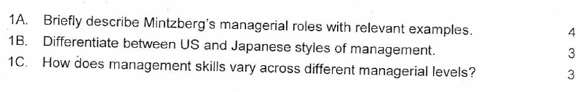
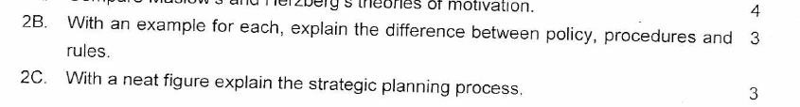


Slide 62
